Slide 1
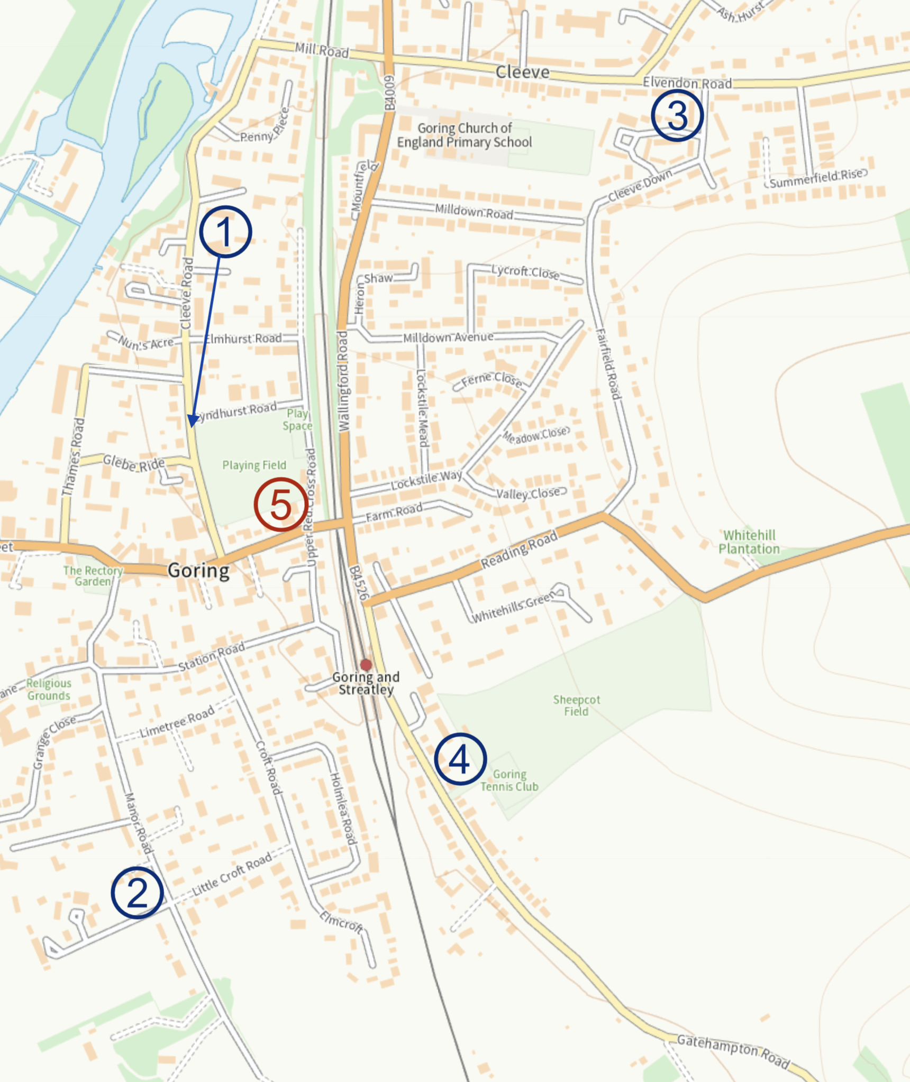
Speed and vehicle data — sensor locations
Sensors were placed in five places
Cleeve Road – nearer to Lyndhurst
Manor Road – by hedgehog sign
Elvendon Rd – near Cleeve Down
Gatehampton Rd – top of slope
Top of the High St – new for 2025
Sensors recorded from
Sun 1 Dec until Mon 9 Dec 2024
Fri 5 Dec until Mon 15 Dec 2025
Five very detailed (and rather complicated) spreadsheets are available.
This deck presents a simpler view, based on raw data
extracted from all five spreadsheets.
Toby Thurston – 23 December 2025

Slide 2
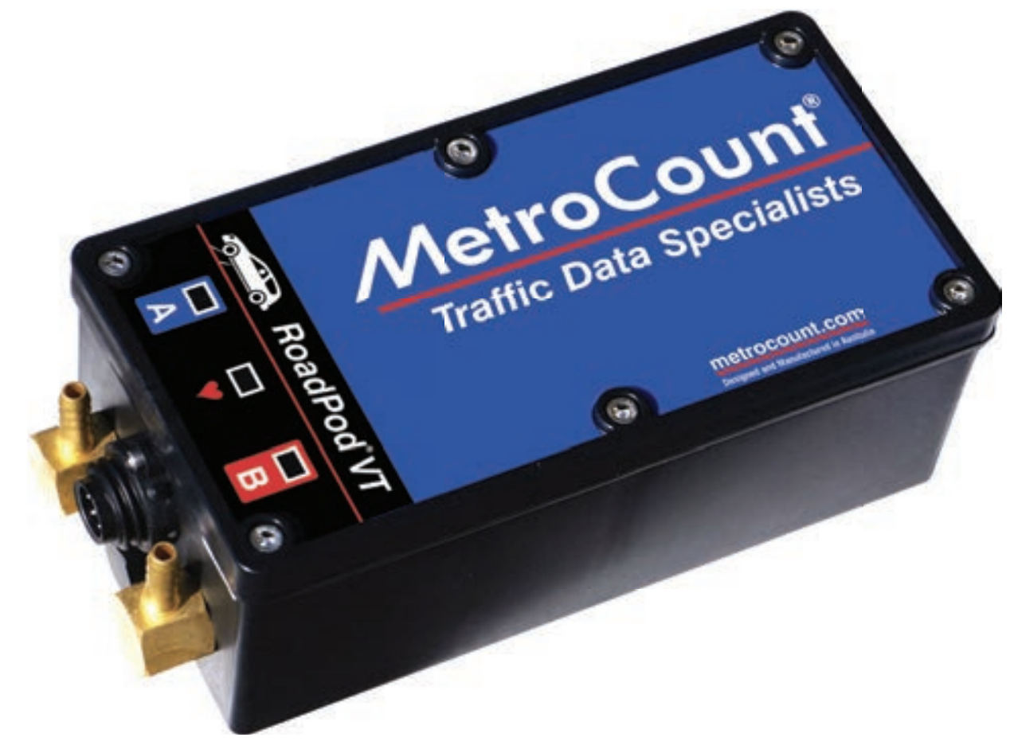
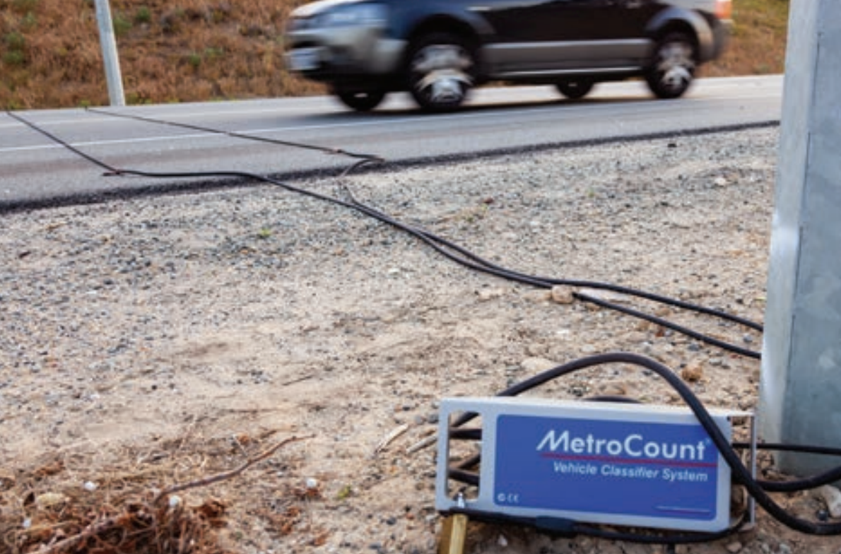
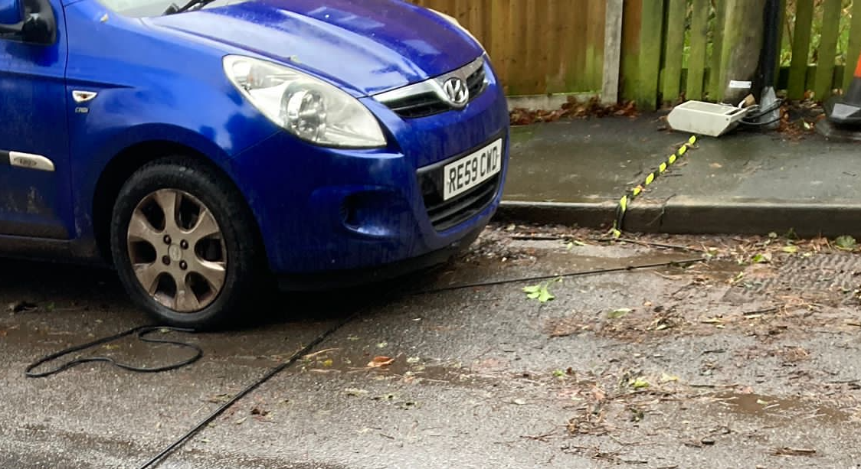
Metrocount sensors
Sensors connect to two rubber tubes
— A and B — spaced 1m apart
Boxes detect changes in air pressure when vehicles cross the tubes
From this they calculate: type of vehicle, number of axles, speed, and direction
Data is summarized into 15 minute “bins”
Both High St tubes broke, but were replaced
Elvendon Road appeared to be unreliable unit
Theory
Reality

Slide 3
Dates and times of operation

Slide 4
Total vehicle counts (and percentages) 2025
Road Dir Cycle M/C Car LGV Rig2 Rig3 Rig4 Art3 Art4 Art5+ Bus Total
Cleeve Road S->N 68 28 2904 254 63 3 0 2 0 1 0 3323
Cleeve Road N->S 56 27 3397 496 61 2 6 3 0 1 0 4049
Manor Road S->N 16 5 1580 324 45 5 2 5 0 0 0 1982
Manor Road N->S 34 9 1761 281 43 19 1 6 0 0 0 2154
Elvendon Road W->E 28 25 2094 474 77 7 2 4 0 0 0 2711
Elvendon Road E->W 39 19 2201 312 62 9 2 4 0 0 0 2648
Gatehampton Road S->N 47 43 2322 508 71 4 1 11 0 2 0 3009
Gatehampton Road N->S 39 39 2369 497 70 3 2 9 0 2 0 3030
B4009 High Street W->E 146 115 17978 1965 299 90 3 53 0 8 7 20664
B4009 High Street E->W 154 117 17457 1590 308 15 7 36 2 3 5 19694
--------------------------------------------------------------------------------------------------
Total Total 627 427 54063 6701 1099 157 26 133 2 17 12 63264
Road Dir Cycle M/C Car LGV Rig2 Rig3 Rig4 Art3 Art4 Art5+ Bus perHr
Cleeve Road S->N 2 1 87 8 2 0 0 0 0 0 0 13
Cleeve Road N->S 1 1 84 12 2 0 0 0 0 0 0 16
Manor Road S->N 1 0 80 16 2 0 0 0 0 0 0 8
Manor Road N->S 2 0 82 13 2 1 0 0 0 0 0 9
Elvendon Road W->E 1 1 77 17 3 0 0 0 0 0 0 15
Elvendon Road E->W 1 1 83 12 2 0 0 0 0 0 0 15
Gatehampton Road S->N 2 1 77 17 2 0 0 0 0 0 0 12
Gatehampton Road N->S 1 1 78 16 2 0 0 0 0 0 0 12
B4009 High Street W->E 1 1 87 10 1 0 0 0 0 0 0 102
B4009 High Street E->W 1 1 89 8 2 0 0 0 0 0 0 97
--------------------------------------------------------------------------------------------------
Total Total 1 1 85 11 2 0 0 0 0 0 0 56
85% cars, 11% vans, and 2% lorries
More cars & vans enter village via Cleeve Rd than leave
Manor Rd has fewest
High St gets x 6 volume
Side roads get higher proportion of vans and lorries
Rig2 = Rigid 2 axles, etc
Art3 = Artic 3 axles, etc
LGV = Vans, or more
likely 4x4 vehicles

Slide 5
Total vehicle counts (and percentages) 2024
Road Dir Cycle M/C Car LGV Rig2 Rig3 Rig4 Art3 Art4 Art5+ Bus Total
Cleeve Road S->N 27 38 1411 306 42 0 0 0 0 0 0 1824
Cleeve Road N->S 22 18 1951 281 47 1 1 0 0 0 0 2321
Manor Road S->N 5 3 1237 227 35 7 0 1 0 1 1 1517
Manor Road N->S 27 3 1162 176 33 9 0 0 0 1 0 1411
Elvendon Road W->E 24 14 2961 627 117 4 3 8 0 0 0 3758
Elvendon Road E->W 24 22 2900 726 110 2 2 6 0 0 0 3792
Gatehampton Road S->N 28 30 1782 652 106 0 1 6 0 0 2 2607
Gatehampton Road N->S 35 24 1681 713 110 1 0 7 0 1 4 2576
-------------------------------------------------------------------------------------------------
Total Total 192 152 15085 3708 600 24 7 28 0 3 7 19806
Road Dir Cycle M/C Car LGV Rig2 Rig3 Rig4 Art3 Art4 Art5+ Bus Total
Cleeve Road S->N 1 2 77 17 2 0 0 0 0 0 0 100
Cleeve Road N->S 1 1 84 12 2 0 0 0 0 0 0 100
Manor Road S->N 0 0 82 15 2 0 0 0 0 0 0 100
Manor Road N->S 2 0 82 12 2 1 0 0 0 0 0 100
Elvendon Road W->E 1 0 79 17 3 0 0 0 0 0 0 100
Elvendon Road E->W 1 1 76 19 3 0 0 0 0 0 0 100
Gatehampton Road S->N 1 1 68 25 4 0 0 0 0 0 0 100
Gatehampton Road N->S 1 1 65 28 4 0 0 0 0 0 0 100
-------------------------------------------------------------------------------------------------
Total Total 1 1 76 19 3 0 0 0 0 0 0 100
76% cars, 19% vans, and 3% lorries
More cars enter village via Cleeve Rd than leave
Manor Rd has fewest
Elvendon has most
Gatehampton gets more vans and lorries
Rig2 = Rigid 2 axles,
Art4 = Artic 4 axles, etc
LGV = Vans, or more
likely 4x4 vehicles
Sensors are possibly not very good at counting two wheelers...
Daily variations show some interesting patterns

Slide 6
Total speed counts (and percentages) 2025
Road Dir <10 <15 <20 <25 <30 <35 <40 <45 <50 <55 <60 Total
Cleeve Road S->N 123 505 1620 936 123 15 1 - - - - 3323
Cleeve Road N->S 95 572 1612 1467 277 22 3 1 - - - 4049
Manor Road S->N 90 438 909 446 83 14 1 1 - - - 1982
Manor Road N->S 174 331 886 563 151 23 10 6 - 3 4 2151
Elvendon Road W->E 44 394 1069 830 302 68 3 1 - - - 2711
Elvendon Road E->W 119 901 801 658 153 15 1 - - - - 2648
Gatehampton Road S->N 64 392 1204 953 361 30 5 - - - - 3009
Gatehampton Road N->S 73 207 969 1290 423 61 7 - - - - 3030
B4009 High Street W->E 389 1965 7895 8304 1858 211 35 7 - - - 20664
B4009 High Street E->W 148 1975 11043 5954 500 55 16 3 - - - 19694
---------------------------------------------------------------------------------------------
Total Total 1319 7680 28008 21401 4231 514 82 19 - 3 4 63261
Road Dir <10 <15 <20 <25 <30 <35 <40 <45 <50 <55 <60 Mean
Cleeve Road S->N 4 15 49 28 4 - - - - - - 19
Cleeve Road N->S 2 14 40 36 7 1 - - - - - 20
Manor Road S->N 5 22 46 23 4 1 - - - - - 18
Manor Road N->S 8 15 41 26 7 1 - - - - - 19
Elvendon Road W->E 2 15 39 31 11 3 - - - - - 20
Elvendon Road E->W 4 34 30 25 6 1 - - - - - 18
Gatehampton Road S->N 2 13 40 32 12 1 - - - - - 20
Gatehampton Road N->S 2 7 32 43 14 2 - - - - - 21
B4009 High Street W->E 2 10 38 40 9 1 - - - - - 20
B4009 High Street E->W 1 10 56 30 3 - - - - - - 19
---------------------------------------------------------------------------------------------
Total Total 2 12 44 34 7 1 - - - - - 20
58% under 20 mph, 92% under 25 mph, 8% too fast
About one vehicle in twelve
is driving over 25 mph
Speeds are much the same as 2024, slightly more drivers staying under 25 mph
Manor Rd lower mean speed (with exceptions)
Gatehampton higher mean speed (but not much)
Excessive speed happens rarely but at all times of the day – Manor Rd 8:00, 13:00, Gatehampton evening

Slide 7
Total speed counts (and percentages) 2025 (without High St)
Road Dir <10 <15 <20 <25 <30 <35 <40 <45 <50 <55 <60 Total
Cleeve Road S->N 123 505 1620 936 123 15 1 - - - - 3323
Cleeve Road N->S 95 572 1612 1467 277 22 3 1 - - - 4049
Manor Road S->N 90 438 909 446 83 14 1 1 - - - 1982
Manor Road N->S 174 331 886 563 151 23 10 6 - 3 4 2151
Elvendon Road W->E 44 394 1069 830 302 68 3 1 - - - 2711
Elvendon Road E->W 119 901 801 658 153 15 1 - - - - 2648
Gatehampton Road S->N 64 392 1204 953 361 30 5 - - - - 3009
Gatehampton Road N->S 73 207 969 1290 423 61 7 - - - - 3030
---------------------------------------------------------------------------------------------
Total Total 782 3740 9070 7143 1873 248 31 9 - 3 4 22903
Road Dir <10 <15 <20 <25 <30 <35 <40 <45 <50 <55 <60 Mean
Cleeve Road S->N 4 15 49 28 4 - - - - - - 19
Cleeve Road N->S 2 14 40 36 7 1 - - - - - 20
Manor Road S->N 5 22 46 23 4 1 - - - - - 18
Manor Road N->S 8 15 41 26 7 1 - - - - - 19
Elvendon Road W->E 2 15 39 31 11 3 - - - - - 20
Elvendon Road E->W 4 34 30 25 6 1 - - - - - 18
Gatehampton Road S->N 2 13 40 32 12 1 - - - - - 20
Gatehampton Road N->S 2 7 32 43 14 2 - - - - - 21
---------------------------------------------------------------------------------------------
Total Total 3 16 40 31 8 1 - - - - - 20
59% under 20 mph, 90% under 25 mph, 9% too fast
About one vehicle in ten
is driving over 25 mph
Speeds are much the same as 2024, very slightly more drivers staying under 25 mph
Manor Rd lower mean speed (with exceptions)
Gatehampton higher mean speed (but not much)
Excessive speed happens rarely but at all times of the day – Manor Rd 8:00, 13:00, Gatehampton evening

Slide 8
Total speed counts (and percentages) 2024
Road Dir <10 <15 <20 <25 <30 <35 <40 <45 <50 <55 <60 Total
Cleeve Road S->N 30 355 830 533 74 2 - - - - - 1824
Cleeve Road N->S 87 347 929 810 140 7 1 - - - - 2321
Manor Road S->N 116 532 631 206 23 4 - 3 2 - - 1517
Manor Road N->S 172 366 570 267 32 1 3 - - - - 1411
Elvendon Road W->E 44 534 1558 1125 416 64 14 3 - - - 3758
Elvendon Road E->W 108 1068 1159 986 399 60 11 1 - - - 3792
Gatehampton Road S->N 50 244 912 944 360 83 11 3 - - - 2607
Gatehampton Road N->S 38 142 646 1070 539 110 26 2 2 1 - 2576
---------------------------------------------------------------------------------------------
Total Total 645 3588 7235 5941 1983 331 66 12 4 1 - 19806
Road Dir <10 <15 <20 <25 <30 <35 <40 <45 <50 <55 <60 Mean
Cleeve Road S->N 2 19 46 29 4 - - - - - - 19
Cleeve Road N->S 4 15 40 35 6 - - - - - - 19
Manor Road S->N 8 35 42 14 2 - - - - - - 16
Manor Road N->S 12 26 40 19 2 - - - - - - 17
Elvendon Road W->E 1 14 41 30 11 2 - - - - - 20
Elvendon Road E->W 3 28 31 26 11 2 - - - - - 19
Gatehampton Road S->N 2 9 35 36 14 3 - - - - - 21
Gatehampton Road N->S 1 6 25 42 21 4 1 - - - - 23
---------------------------------------------------------------------------------------------
Total Total 3 18 37 30 10 2 - - - - - 20
58% under 20 mph, 88% under 25 mph, 12% too fast
About one vehicle in eight
is driving over 25 mph
Manor Rd lowest mean speed (with exceptions)
Gatehampton highest mean speed
Excessive speed happens rarely but at all times of the day – Manor Rd 8:00, 13:00, Gatehampton evening
Consider physical speed controls – build outs or humps or raised tables – for Elvendon and Gatehampton
The measurement points in both cases have houses on both sides and pavements exposed to traffic

Slide 9
Cleeve Road — When busy? When speeding?
Date Road Counts Mean Max
Thu 11 08:00 Cleeve Road N->S 16 = Car:15, LGV:1 24 <30
Fri 12 08:15 Cleeve Road N->S 17 = Car:15, Cycle:1, LGV:1 20 <25
Wed 10 08:15 Cleeve Road N->S 15 = Car:14, LGV:1 24 <30
Sat 13 10:30 Cleeve Road N->S 16 = Car:13, M/C:1, LGV:1, Rig2:1 21 <30
Wed 10 11:15 Cleeve Road S->N 15 = Cycle:5, Car:5, LGV:2, Rig2:2, Art5+:1 12 <20
Fri 12 11:15 Cleeve Road S->N 15 = Car:12, Rig2:2, LGV:1 19 <25
Fri 12 15:15 Cleeve Road N->S 16 = Car:14, M/C:1, LGV:1 21 <30
Thu 11 15:15 Cleeve Road S->N 15 = Car:12, LGV:2, Rig2:1 22 <30
Mon 08 15:30 Cleeve Road S->N 15 = Car:12, LGV:2, M/C:1 18 <30
Fri 05 17:45 Cleeve Road N->S 15 = Car:15 16 <20
Date Road Counts Mean Max
Sat 13 00:15 Cleeve Road N->S 1 = Car:1 38 <40
Sat 13 03:00 Cleeve Road S->N 1 = Car:1 33 <35
Mon 15 04:30 Cleeve Road N->S 1 = LGV:1 43 <45
Sun 14 05:45 Cleeve Road N->S 1 = Car:1 33 <35
Fri 12 06:30 Cleeve Road N->S 1 = Car:1 33 <35
Mon 15 22:30 Cleeve Road S->N 1 = M/C:1 33 <35
Sat 13 22:45 Cleeve Road N->S 1 = Car:1 38 <40
Wed 10 22:45 Cleeve Road S->N 1 = Car:1 33 <35
Sun 14 23:15 Cleeve Road N->S 1 = Car:1 33 <35
Sat 06 23:30 Cleeve Road S->N 1 = Car:1 28 <30
Commuting rat run?
Busy times 08:15, 15:15
Commuting to work?
Back from school run?
More traffic coming into the village (N to S)
Mostly less than 25 mph
Opportunist speeding
Single cars in quiet periods
Late evening or night
Both directions
Fastest was 40 – 45 mph

Slide 10
Cleve Road — aggregate class by time of day
Hour Cycle M/C Car LGV Rig2 Rig3 Rig4 Art3 Art4 Art5+ Bus Total per Hour
0 0 0 15 0 0 0 0 0 0 0 0 15 2
1 0 0 13 0 0 0 0 0 0 0 0 13 1
2 0 0 9 0 0 0 0 0 0 0 0 9 1
3 0 0 7 0 0 0 0 0 0 0 0 7 1
4 0 0 2 1 0 0 0 0 0 0 0 3 0
5 0 0 11 1 0 0 0 0 0 0 0 12 1
6 1 0 79 7 1 0 0 0 0 0 0 88 9
7 2 1 248 37 3 0 0 0 0 0 0 291 29
8 7 5 441 54 6 1 0 1 0 0 0 515 52
9 15 6 451 62 9 0 2 0 0 1 0 546 55
10 15 5 494 47 15 0 0 1 0 0 0 577 58
11 19 1 449 59 17 3 3 0 0 1 0 552 55
12 16 9 458 57 20 0 0 1 0 0 0 561 56
13 13 5 451 46 6 0 0 1 0 0 0 522 52
14 8 1 519 60 13 1 0 0 0 0 0 602 55
15 4 3 591 84 12 0 0 0 0 0 0 694 63
16 6 5 574 77 6 0 1 0 0 0 0 669 61
17 8 5 484 51 6 0 0 1 0 0 0 555 50
18 2 5 336 39 3 0 0 0 0 0 0 385 35
19 7 1 246 26 4 0 0 0 0 0 0 284 26
20 0 0 176 22 3 0 0 0 0 0 0 201 18
21 0 2 118 8 0 0 0 0 0 0 0 128 12
22 1 1 87 9 0 0 0 0 0 0 0 98 9
23 0 0 42 3 0 0 0 0 0 0 0 45 4
---------------------------------------------------------------------------------------
Total 124 55 6301 750 124 5 6 5 0 2 0 7372 29

Slide 11
Manor Road — When busy? When speeding?
Date Road Counts Mean Max
Thu 11 07:45 Manor Road N->S 13 = Car:9, LGV:3, Rig2:1 24 <35
Thu 11 10:30 Manor Road N->S 15 = Car:11, LGV:3, Rig2:1 17 <20
Sat 06 11:00 Manor Road S->N 13 = Car:11, Rig2:2 19 <25
Sat 13 11:45 Manor Road S->N 13 = Car:10, LGV:3 17 <20
Mon 15 12:15 Manor Road S->N 15 = Car:13, LGV:2 16 <20
Mon 08 15:00 Manor Road S->N 12 = Car:9, LGV:2, Rig2:1 16 <25
Sun 07 15:00 Manor Road N->S 12 = Car:11, Cycle:1 16 <25
Thu 11 15:15 Manor Road S->N 13 = Car:9, LGV:2, Cycle:1, Art3:1 16 <25
Mon 08 15:30 Manor Road N->S 13 = Car:9, LGV:3, Cycle:1 21 <30
Thu 11 16:00 Manor Road S->N 12 = Car:8, LGV:3, Rig2:1 21 <30
Date Road Counts Mean Max
Wed 10 08:15 Manor Road N->S 9 = Car:5, LGV:3, Rig3:1 32 <55
Fri 05 15:00 Manor Road N->S 5 = Car:4, LGV:1 34 <45
Thu 11 20:00 Manor Road N->S 4 = Car:4 58 <60 <- FFS?
Sat 06 20:00 Manor Road N->S 3 = Car:3 35 <40
Fri 12 20:00 Manor Road S->N 1 = Car:1 33 <35
Sun 07 20:00 Manor Road N->S 1 = Car:1 33 <35
Fri 05 20:15 Manor Road S->N 1 = Car:1 28 <30
Fri 12 22:30 Manor Road N->S 6 = Car:6 34 <45 <- FFS?
Fri 12 22:30 Manor Road S->N 1 = Car:1 33 <35
Sat 06 00:15 Manor Road N->S 2 = Car:2 30 <35
Still building work
Busy daylight hours
But not that busy
Traffic both ways
LGVs here are 4x4s
Mostly less than 25 mph
with exceptions...
Speeding by several cars
Worst in evening
Similar "boy racer" pattern was seen in 2024
No excuse for 60 mph here, heading to dead end...

Slide 12
Manor Road — aggregate class by time of day
Hour Cycle M/C Car LGV Rig2 Rig3 Rig4 Art3 Art4 Art5+ Bus Total per Hour
0 0 0 19 3 0 0 0 0 0 0 0 22 2
1 0 0 5 0 2 0 0 0 0 0 0 7 1
2 0 0 1 0 1 0 0 0 0 0 0 2 0
3 0 0 1 0 0 0 0 0 0 0 0 1 0
4 0 0 4 0 0 0 0 0 0 0 0 4 0
5 0 0 8 0 1 0 0 0 0 0 0 9 1
6 0 0 29 6 0 0 0 0 0 0 0 35 4
7 0 1 154 44 3 0 0 1 0 0 0 203 20
8 0 1 191 51 6 1 0 3 0 0 0 253 25
9 10 1 209 51 12 0 1 2 0 0 0 286 29
10 5 1 256 45 12 3 1 0 0 0 0 323 32
11 8 1 283 48 6 3 0 1 0 0 0 350 35
12 4 1 254 44 12 2 0 0 0 0 0 317 32
13 5 3 216 52 6 2 0 0 0 0 0 284 28
14 1 2 212 55 7 6 0 1 0 0 0 284 26
15 8 2 354 66 4 1 1 3 0 0 0 439 40
16 1 0 306 58 6 1 0 0 0 0 0 372 34
17 1 0 230 22 3 1 0 0 0 0 0 257 23
18 0 0 172 27 2 1 0 0 0 0 0 202 18
19 5 0 158 13 2 2 0 0 0 0 0 180 16
20 0 1 122 10 1 0 0 0 0 0 0 134 12
21 1 0 72 3 1 1 0 0 0 0 0 78 7
22 1 0 59 6 0 0 0 0 0 0 0 66 6
23 0 0 26 1 1 0 0 0 0 0 0 28 3
---------------------------------------------------------------------------------------
Total 50 14 3341 605 88 24 3 11 0 0 0 4136 16

Slide 13
Elvendon Road — When busy? When speeding?
Date Road Counts Mean Max
Mon 08 08:00 Elvendon Road E->W 21 = Car:19, LGV:2 18 <30
Tue 09 08:00 Elvendon Road E->W 19 = Car:17, LGV:2 20 <25
Fri 12 08:00 Elvendon Road E->W 17 = Car:15, LGV:2 19 <30
Fri 12 08:30 Elvendon Road E->W 17 = Car:10, LGV:7 20 <30
Sat 06 10:15 Elvendon Road E->W 19 = Car:18, Cycle:1 16 <25
Mon 15 11:45 Elvendon Road W->E 18 = Car:14, LGV:3, M/C:1 22 <30
Sat 06 12:45 Elvendon Road W->E 23 = Car:19, LGV:3, Cycle:1 20 <30
Thu 11 15:45 Elvendon Road W->E 23 = Car:20, LGV:3 20 <30
Mon 08 15:45 Elvendon Road W->E 19 = Car:17, LGV:2 20 <30
Mon 08 18:15 Elvendon Road E->W 19 = Car:16, LGV:2, Rig2:1 19 <35
Date Road Counts Mean Max
Sat 13 07:30 Elvendon Road W->E 2 = LGV:2 33 <40
Sat 13 07:45 Elvendon Road W->E 3 = LGV:2, Car:1 28 <40
Sat 13 09:00 Elvendon Road W->E 3 = LGV:2, Car:1 30 <45
Sat 13 10:45 Elvendon Road E->W 2 = Car:1, LGV:1 30 <35
Mon 15 19:45 Elvendon Road W->E 2 = Car:2 28 <35
Thu 11 20:00 Elvendon Road E->W 1 = Car:1 28 <30
Mon 08 20:30 Elvendon Road E->W 1 = Car:1 28 <30
Fri 12 22:00 Elvendon Road E->W 1 = Car:1 28 <30
Thu 11 23:00 Elvendon Road W->E 1 = LGV:1 33 <35
Sat 13 02:45 Elvendon Road E->W 1 = LGV:1 28 <30
Station run?
Busy into village (E to W) in the morning
Busy other way (W to E) in afternoon
Usual some over 25 mph
Includes vans / pickups
Speeding by individuals
But small groups of LGVs on Sat 13
Max speeds over 30 mph, dangerous in residential road

Slide 14
Elvendon Road — aggregate class by time of day
Hour Cycle M/C Car LGV Rig2 Rig3 Rig4 Art3 Art4 Art5+ Bus Total per Hour
0 0 0 10 0 0 0 0 0 0 0 0 10 1
1 0 0 7 0 0 0 0 0 0 0 0 7 1
2 0 0 1 1 1 0 0 0 0 0 0 3 0
3 0 0 0 1 0 0 0 0 0 0 0 1 0
4 0 0 3 4 1 0 0 0 0 0 0 8 1
5 0 0 23 2 0 0 0 0 0 0 0 25 3
6 2 2 47 11 0 0 0 0 0 0 0 62 8
7 0 4 161 20 1 1 0 2 0 0 0 189 25
8 6 2 249 63 5 0 0 1 0 0 0 326 43
9 3 1 213 34 7 0 1 0 0 0 0 259 34
10 7 1 343 50 15 1 2 1 0 0 0 420 55
11 15 7 357 83 16 6 0 0 0 0 0 484 64
12 6 6 389 67 21 0 0 1 0 0 0 490 65
13 4 3 362 75 17 1 0 0 0 0 0 462 61
14 4 5 365 71 14 1 0 3 0 0 0 463 61
15 6 3 445 81 15 0 1 0 0 0 0 551 73
16 8 1 303 71 10 2 0 0 0 0 0 395 52
17 2 1 327 44 2 1 0 0 0 0 0 377 50
18 1 3 269 47 4 1 0 0 0 0 0 325 43
19 2 1 180 33 3 1 0 0 0 0 0 220 29
20 1 2 93 16 4 1 0 0 0 0 0 117 15
21 0 2 72 5 3 0 0 0 0 0 0 82 11
22 0 0 53 5 0 0 0 0 0 0 0 58 8
23 0 0 23 2 0 0 0 0 0 0 0 25 3
---------------------------------------------------------------------------------------
Total 67 44 4295 786 139 16 4 8 0 0 0 5359 29

Slide 15
Gatehampton Road — When busy? When speeding?
Date Road Counts Mean Max
Sat 06 09:00 Gatehampton Road S->N 19 = Car:16, LGV:2, Cycle:1 15 <30
Sat 13 10:45 Gatehampton Road S->N 16 = Car:11, LGV:3, M/C:1, Art3:1 19 <25
Sat 13 12:15 Gatehampton Road S->N 18 = Car:17, LGV:1 18 <25
Sat 13 12:15 Gatehampton Road N->S 16 = Car:14, Cycle:1, LGV:1 23 <35
Sat 06 12:45 Gatehampton Road N->S 17 = Car:16, LGV:1 23 <30
Sat 13 13:30 Gatehampton Road N->S 17 = Car:14, LGV:2, Cycle:1 20 <30
Sat 06 13:45 Gatehampton Road N->S 17 = Car:13, LGV:4 24 <30
Sat 06 15:45 Gatehampton Road S->N 20 = Car:16, LGV:3, M/C:1 18 <25
Sat 06 16:00 Gatehampton Road S->N 33 = Car:32, LGV:1 19 <40
Sat 13 16:00 Gatehampton Road S->N 17 = Car:17 21 <30
Date Road Counts Mean Max
Mon 08 04:30 Gatehampton Road S->N 1 = LGV:1 38 <40
Sat 13 05:45 Gatehampton Road S->N 1 = LGV:1 33 <35
Sun 14 05:45 Gatehampton Road S->N 1 = LGV:1 33 <35
Fri 12 06:00 Gatehampton Road N->S 3 = Car:2, LGV:1 31 <35
Sat 06 19:15 Gatehampton Road S->N 1 = Car:1 33 <35
Tue 09 19:15 Gatehampton Road N->S 1 = Car:1 33 <35
Mon 08 19:30 Gatehampton Road N->S 1 = Car:1 38 <40
Sat 13 19:45 Gatehampton Road S->N 1 = LGV:1 33 <35
Mon 15 19:45 Gatehampton Road S->N 1 = LGV:1 33 <35
Mon 08 20:30 Gatehampton Road S->N 2 = Car:2 30 <40
Football traffic
Busy times all on Saturdays, to and from Sheepcot
Speeding by individuals
Early morning vans
Evening cars

Slide 16
Gatehampton Road — aggregate class by time of day
Hour Cycle M/C Car LGV Rig2 Rig3 Rig4 Art3 Art4 Art5+ Bus Total per Hour
0 0 0 10 1 0 0 0 0 0 0 0 11 1
1 0 0 6 2 0 0 0 0 0 0 0 8 1
2 0 0 2 3 1 0 0 0 0 0 0 6 1
3 0 0 2 3 1 0 0 0 0 0 0 6 1
4 0 0 3 2 0 0 0 0 0 0 0 5 0
5 0 3 16 10 0 0 0 0 0 0 0 29 3
6 0 2 73 10 0 0 0 0 0 0 0 85 8
7 3 7 188 55 2 0 0 0 0 2 0 257 26
8 5 5 324 62 9 1 0 3 0 1 0 410 41
9 15 8 389 82 13 0 0 2 0 0 0 509 51
10 9 13 375 82 22 1 0 2 0 1 0 505 50
11 8 5 328 84 27 3 0 2 0 0 0 457 46
12 17 4 383 88 16 1 1 3 0 0 0 513 51
13 8 10 342 75 9 0 0 3 0 0 0 447 45
14 7 3 355 86 14 0 1 1 0 0 0 467 42
15 7 10 471 114 13 1 0 3 0 0 0 619 56
16 5 4 427 72 3 0 0 0 0 0 0 511 46
17 1 1 266 54 5 0 0 0 0 0 0 327 30
18 0 2 252 40 4 0 0 0 0 0 0 298 27
19 0 1 227 39 1 0 1 1 0 0 0 270 25
20 0 3 121 20 1 0 0 0 0 0 0 145 13
21 1 0 68 11 0 0 0 0 0 0 0 80 7
22 0 1 40 5 0 0 0 0 0 0 0 46 4
23 0 0 23 5 0 0 0 0 0 0 0 28 3
----------------------------------------------------------------------------------------
Total 86 82 4691 1005 141 7 3 20 0 4 0 6039 24

Slide 17
B4009 High Street — When busy? When speeding?
Date Road Counts Mean Max
Mon 08 08:15 B4009 High Street W->E 84 = Car:70, LGV:8, Rig2:2, Rig3:2, Cycle:1, Bus:1 19 <35
Thu 11 08:30 B4009 High Street W->E 93 = Car:81, LGV:10, Rig2:2 17 <30
Mon 08 08:30 B4009 High Street W->E 78 = Car:66, LGV:5, Rig3:5, Art3:1, Art5+:1 19 <30
Fri 05 15:15 B4009 High Street E->W 78 = Car:66, LGV:8, Rig2:2, M/C:1, Art3:1 19 <30
Fri 12 15:30 B4009 High Street W->E 80 = Car:66, LGV:10, M/C:3, Cycle:1 18 <30
Fri 12 15:45 B4009 High Street E->W 76 = Car:59, LGV:15, Cycle:1, M/C:1 18 <25
Mon 15 16:00 B4009 High Street E->W 79 = Car:70, LGV:7, Rig2:1, Bus:1 15 <25
Mon 08 16:30 B4009 High Street E->W 78 = Car:70, LGV:7, Rig2:1 18 <30
Mon 08 17:00 B4009 High Street W->E 75 = Car:68, Rig3:5, LGV:2 20 <30
Mon 08 17:30 B4009 High Street W->E 78 = Car:69, Rig3:4, LGV:3, M/C:1, Art3:1 20 <30
Date Road Counts Mean Max
Mon 08 01:00 B4009 High Street W->E 1 = Car:1 33 <35
Mon 15 01:15 B4009 High Street W->E 1 = Car:1 38 <40
Sat 06 02:30 B4009 High Street W->E 1 = LGV:1 33 <35
Sat 13 04:30 B4009 High Street W->E 1 = Car:1 38 <40
Mon 08 04:30 B4009 High Street W->E 2 = Car:1, LGV:1 33 <40
Mon 08 05:00 B4009 High Street W->E 1 = Car:1 33 <35
Sat 06 05:15 B4009 High Street W->E 1 = LGV:1 33 <35
Sun 14 05:30 B4009 High Street W->E 1 = Car:1 43 <45
Sat 13 06:00 B4009 High Street W->E 2 = Car:2 36 <40
Sun 07 06:45 B4009 High Street W->E 2 = Car:2 33 <35
Main through road
Tidal flow – up to rail bridge 8:15–8:30
Afternoon peaks in both directions
Volume about 6 times more than side roads
Speeding by individuals
All at night, which is pretty anti-social
All west to east (due to sensor position)
All at weekends
Suggest closing river bridge at night at weekends

Slide 18
B4009 High Street — aggregate class by time of day
Hour Cycle M/C Car LGV Rig2 Rig3 Rig4 Art3 Art4 Art5+ Bus Total per Hour
0 1 0 164 10 1 0 0 0 0 0 0 176 22
1 0 0 48 5 2 0 0 0 0 0 0 55 7
2 0 0 36 4 0 0 0 0 0 0 0 40 5
3 0 0 27 1 1 0 0 0 0 0 0 29 4
4 0 0 32 10 6 0 0 0 0 0 0 48 6
5 0 3 113 19 5 0 0 0 0 0 0 140 18
6 4 1 450 66 12 0 0 1 0 0 0 534 67
7 13 10 1511 288 25 2 0 7 0 0 3 1859 232
8 20 17 2222 245 43 16 1 13 0 4 2 2583 323
9 38 13 2311 246 63 4 1 10 0 0 0 2686 336
10 37 22 2399 249 60 4 3 5 1 1 1 2782 348
11 35 14 2470 273 75 11 0 8 1 1 0 2888 361
12 33 25 2714 264 63 11 2 11 0 1 2 3126 391
13 28 26 2454 246 56 11 1 8 0 0 0 2830 354
14 22 20 2664 301 66 5 0 6 0 1 0 3085 343
15 32 23 3191 349 52 5 1 11 0 1 0 3665 407
16 6 17 3225 315 21 16 0 4 0 2 2 3608 401
17 6 12 2847 219 15 13 1 3 0 0 0 3116 346
18 4 8 2180 134 13 7 0 1 0 0 2 2349 261
19 10 4 1690 119 10 0 0 1 0 0 0 1834 204
20 2 4 982 85 10 0 0 0 0 0 0 1083 120
21 0 5 718 49 5 0 0 0 0 0 0 777 86
22 6 7 617 38 0 0 0 0 0 0 0 668 74
23 3 1 370 20 3 0 0 0 0 0 0 397 44
-----------------------------------------------------------------------------------------
Total 300 232 35435 3555 607 105 10 89 2 11 12 40358 198

Slide 19
All sensors — aggregate class by time of day
Hour Cycle M/C Car LGV Rig2 Rig3 Rig4 Art3 Art4 Art5+ Bus Total
0 1 0 218 14 1 0 0 0 0 0 0 234
1 0 0 79 7 4 0 0 0 0 0 0 90
2 0 0 49 8 3 0 0 0 0 0 0 60
3 0 0 37 5 2 0 0 0 0 0 0 44
4 0 0 44 17 7 0 0 0 0 0 0 68
5 0 6 171 32 6 0 0 0 0 0 0 215
6 7 5 678 100 13 0 0 1 0 0 0 804
7 18 23 2262 444 34 3 0 10 0 2 3 2799
8 38 30 3427 475 69 19 1 21 0 5 2 4087
9 81 29 3573 475 104 4 5 14 0 1 0 4286
10 73 42 3867 473 124 9 6 9 1 2 1 4607
11 85 28 3887 547 141 26 3 11 1 2 0 4731
12 76 45 4198 520 132 14 3 16 0 1 2 5007
13 58 47 3825 494 94 14 1 12 0 0 0 4545
14 42 31 4115 573 114 13 1 11 0 1 0 4901
15 57 41 5052 694 96 7 3 17 0 1 0 5968
16 26 27 4835 593 46 19 1 4 0 2 2 5555
17 18 19 4154 390 31 15 1 4 0 0 0 4632
18 7 18 3209 287 26 9 0 1 0 0 2 3559
19 24 7 2501 230 20 3 1 2 0 0 0 2788
20 3 10 1494 153 19 1 0 0 0 0 0 1680
21 2 9 1048 76 9 1 0 0 0 0 0 1145
22 8 9 856 63 0 0 0 0 0 0 0 936
23 3 1 484 31 4 0 0 0 0 0 0 523
-------------------------------------------------------------------------------
Total 627 427 54063 6701 1099 157 26 133 2 17 12 63264

